Slide 1
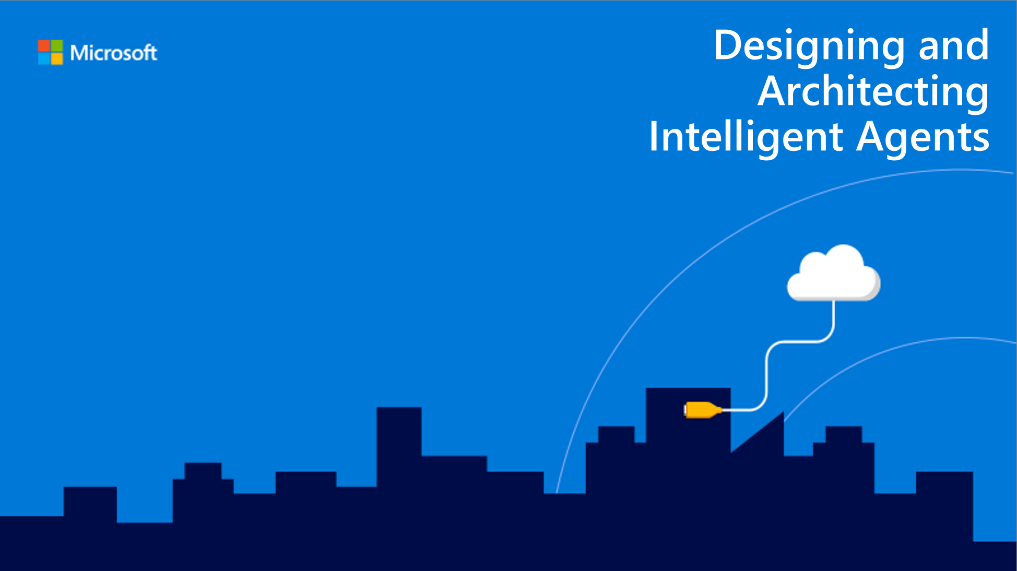
Reference Architectures and Common Patterns
Speaker name

Slide 2
Session objectives and takeaways
At the end of this session, you should be able to…
Articulate the key scenarios for bots and their associated architectures
Explain common patterns for bots and the best practices for dealing with them
Prepare for the release of the new bot framework SDK

Slide 3
Agenda
Key scenarios for bots
Common patterns
Bot Framework V4 SDK

Slide 4
Key scenarios for bots
Cortana
Enterprise Productivity
Information
Internet of Things (IoT)
Commerce

Slide 5
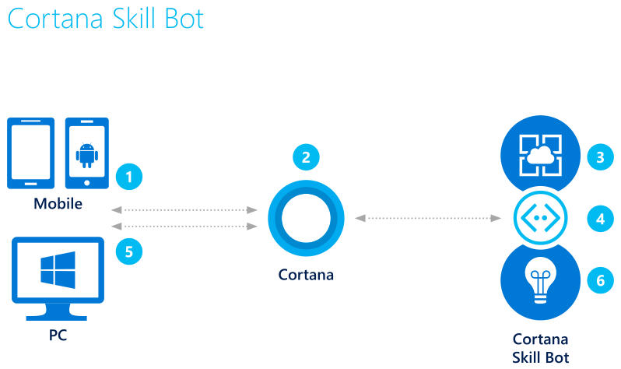
Cortana skills bot
Cortana skills bot
3. Bot accesses user’s calendar and applies logic to the request
Example: Auto appointment
2. Using either text or voice commands, the user asks for an automobile maintenance appointment
1. The user accesses Cortana from their PC or mobile device
4. Queries the auto service for valid appointments
5. Bot presents user with options, user can book appointment
6. Application insights gathers runtime telemetry to help development with bot performance and usage
Key scenarios for bots

Slide 6
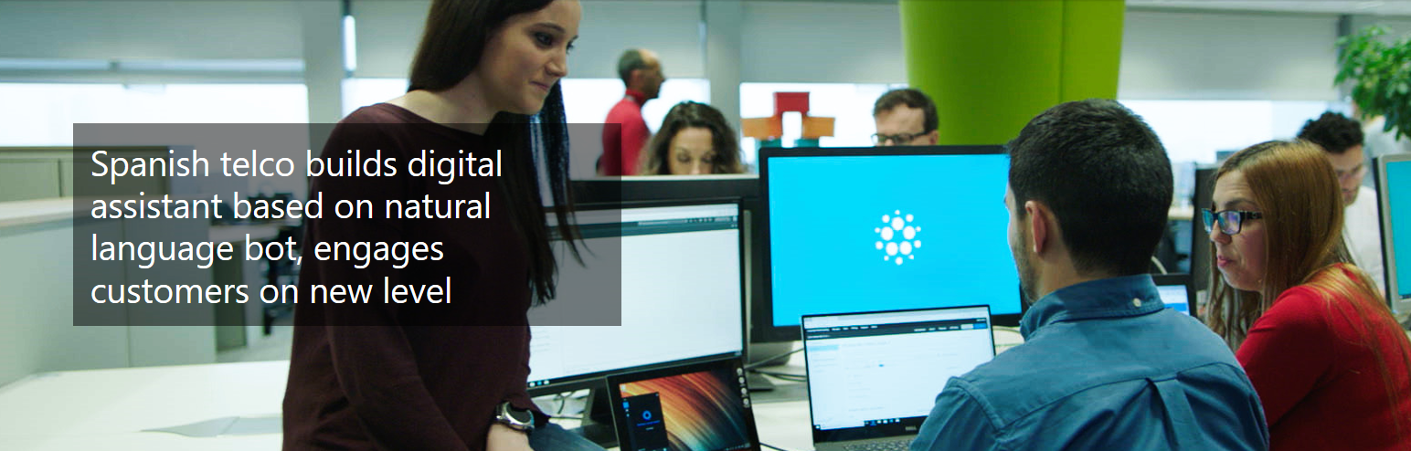
Cortana skills bot
Cortana skills bot - Telefonica
https://aura.telefonica.com/use-cases
Key scenarios for bots

Slide 7
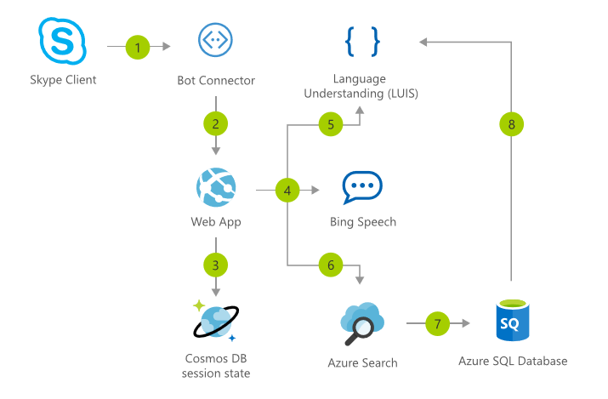
Cortana skills bot
Cortana skills bot - aside
AI Gallery Solution: IVR Bot – Bike Store
Key scenarios for bots

Slide 8
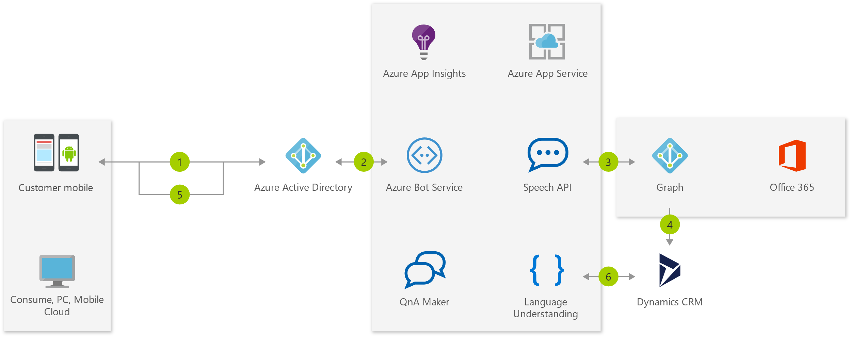
Enterprise Productivity bot
Enterprise Productivity bot
Example: Access other services
3. The bot is able to query the employee’s O365 calendar via Azure Graph
1. The employee accesses the bot
7. Application insights gathers runtime telemetry
5. The information is returned to the employee who can filter down the data from the bot
2. AAD validates the employee’s identity
4/6. Using data gathered from the calendar, the bot accesses case information in Dynamics CRM
Key scenarios for bots

Slide 9
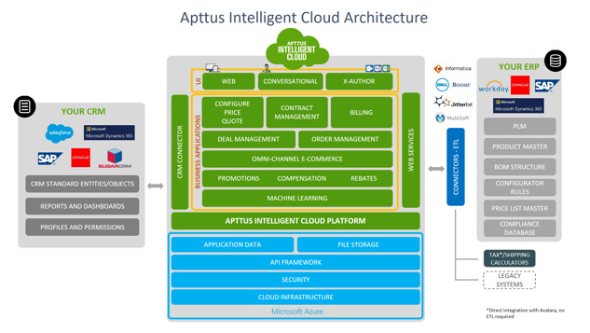
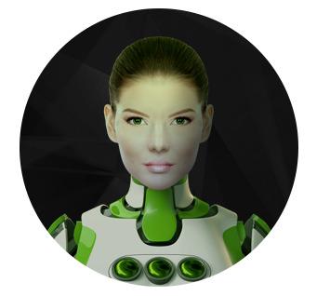
Enterprise Productivity bot - Apttus
Key scenarios for bots

Slide 10
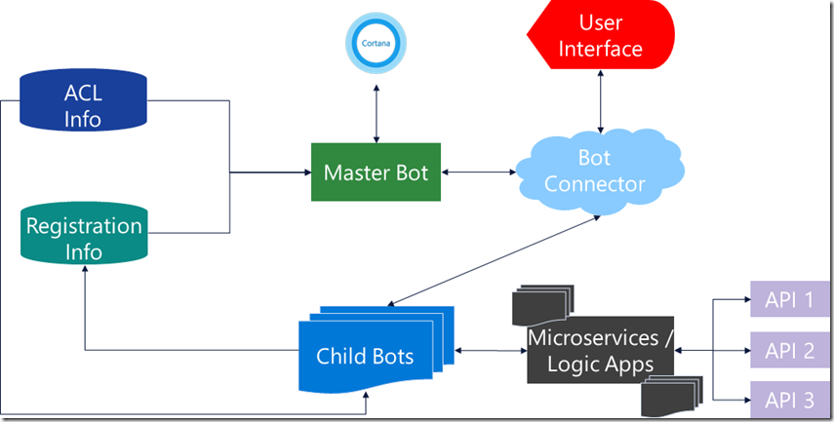
Enterprise Productivity bot
Aside: Creating Bots for Enterprises
Search for “Brad Lawrence Enterprise Bot Architecture Blog”
Key scenarios for bots
https://blogs.msdn.microsoft.com/pragdev/2018/02/10/enterprise-bot-architecture/

Slide 11
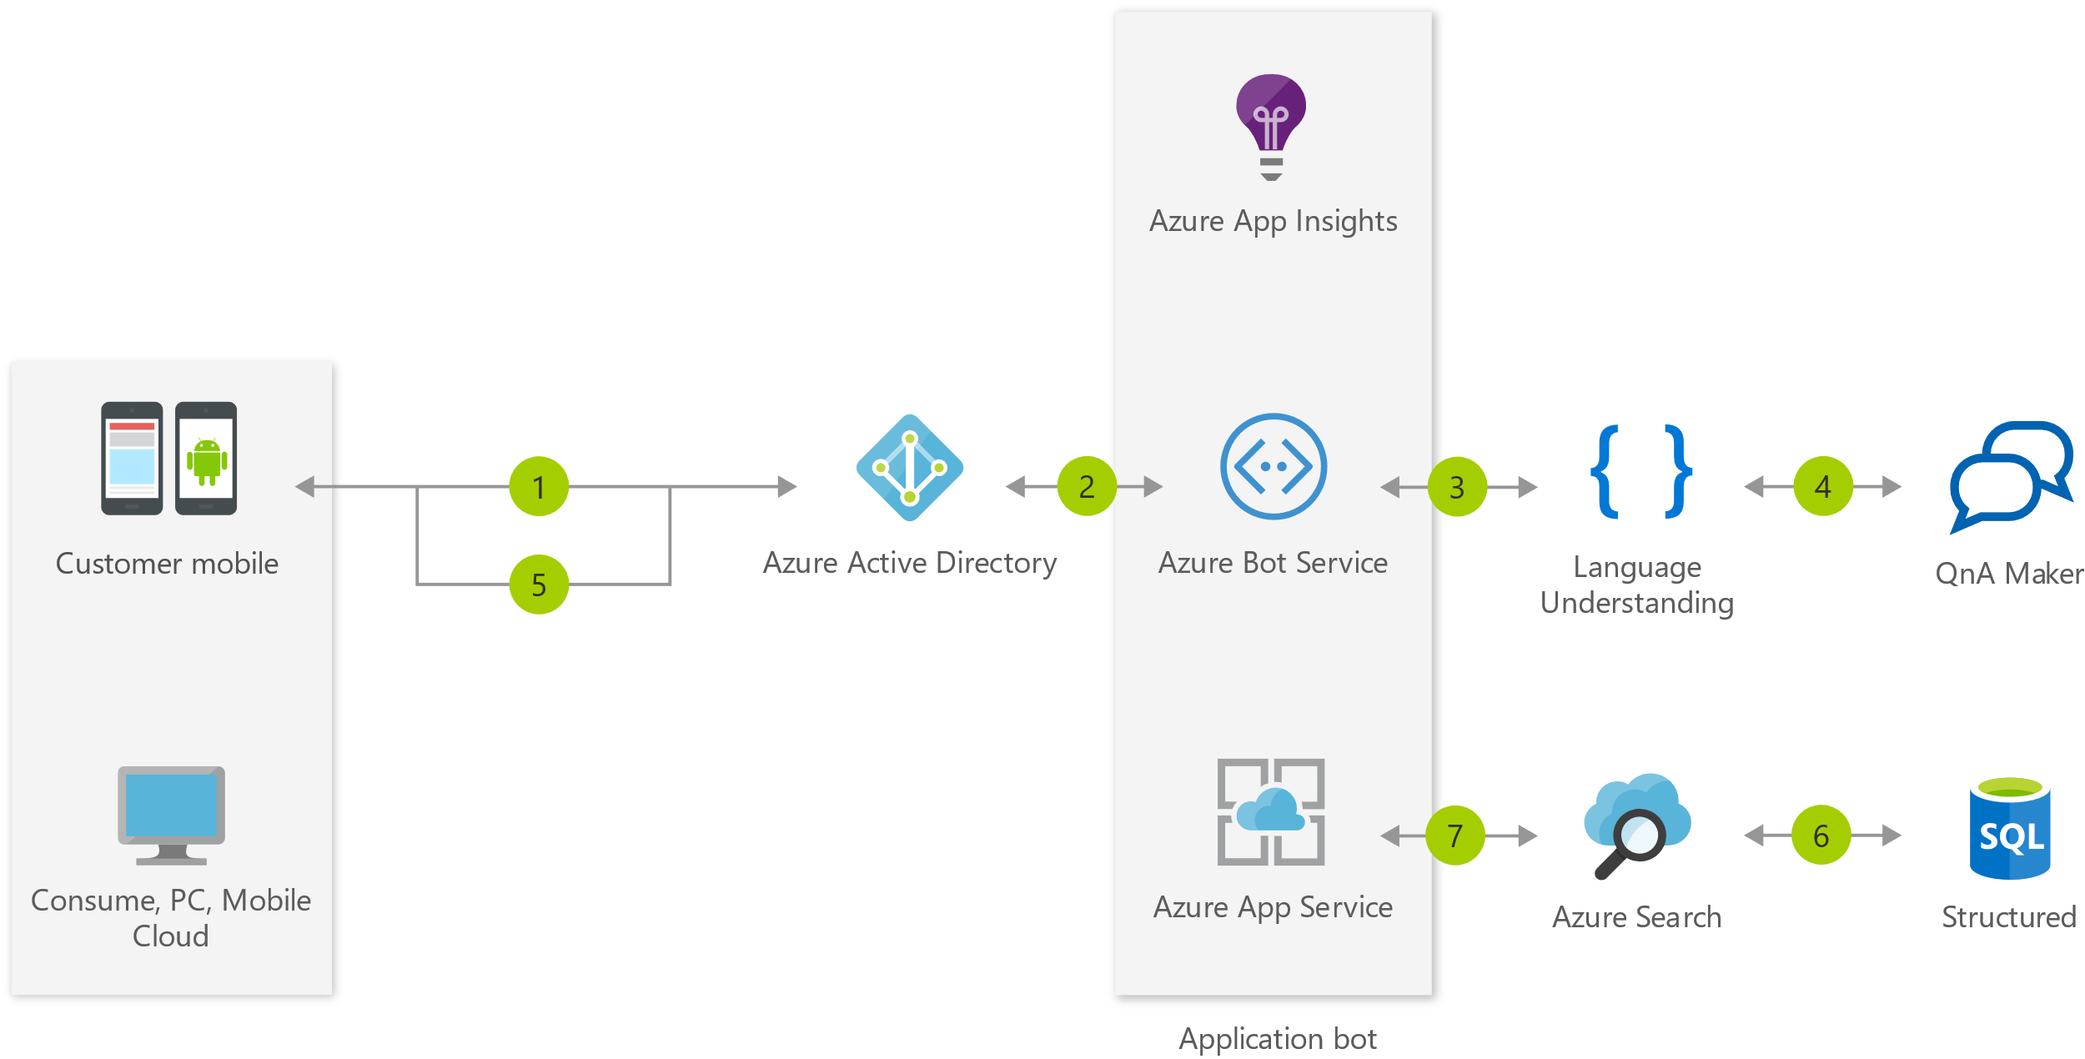
Information bot
Information bot
Example: Customer order status
7. Application insights gathers runtime telemetry
3. The employee can ask the bot what type of queries are supported
1. The employee starts the information bot
5. The employee responds with a valid query
2. AAD validates the employee’s identity
4. Using QnA Maker, the bot processes the request and gives answer
6. The bot submits the query to Azure Search which returns info from SQL to the user
Key scenarios for bots

Slide 12
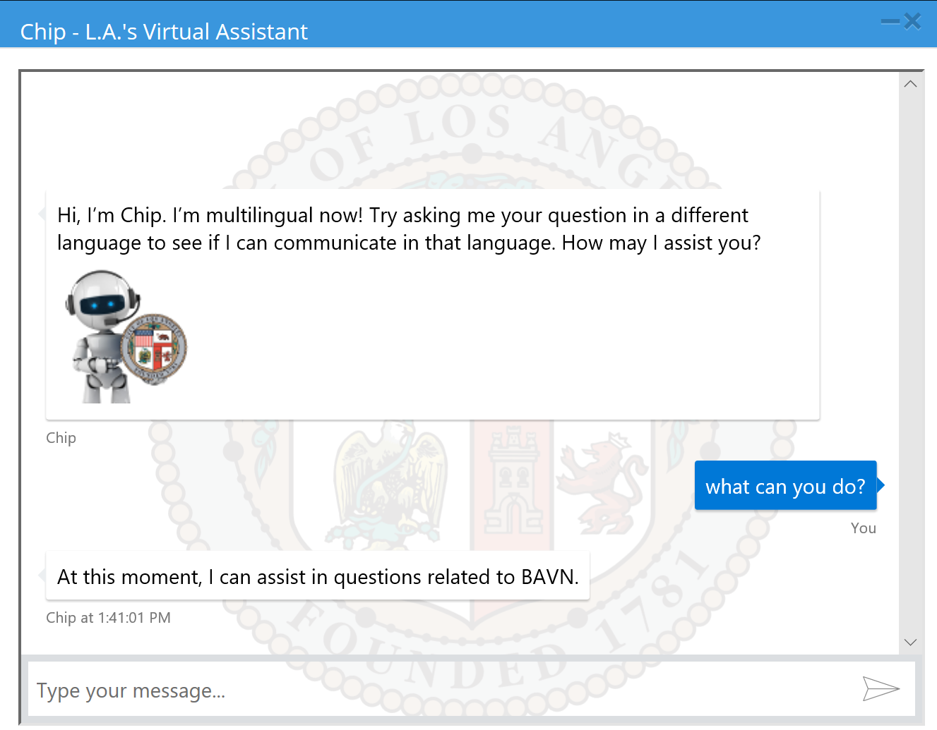
Information bot
Information bot - Chip
Key scenarios for bots

Slide 13
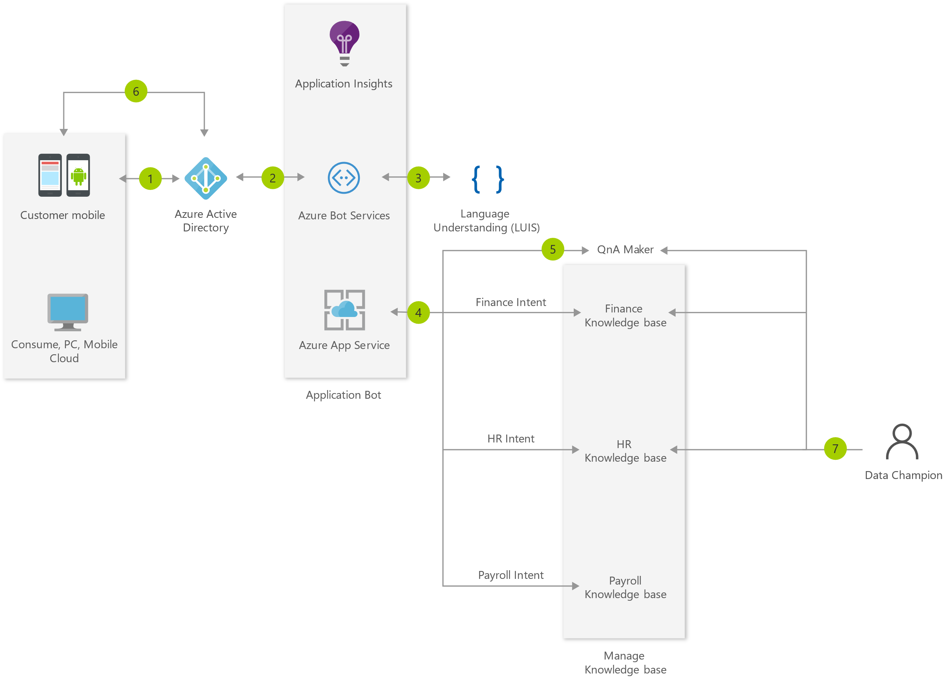
Information bot
Information bot
Example Architecture:
FAQ Bot for Enterprise
Key scenarios for bots

Slide 14
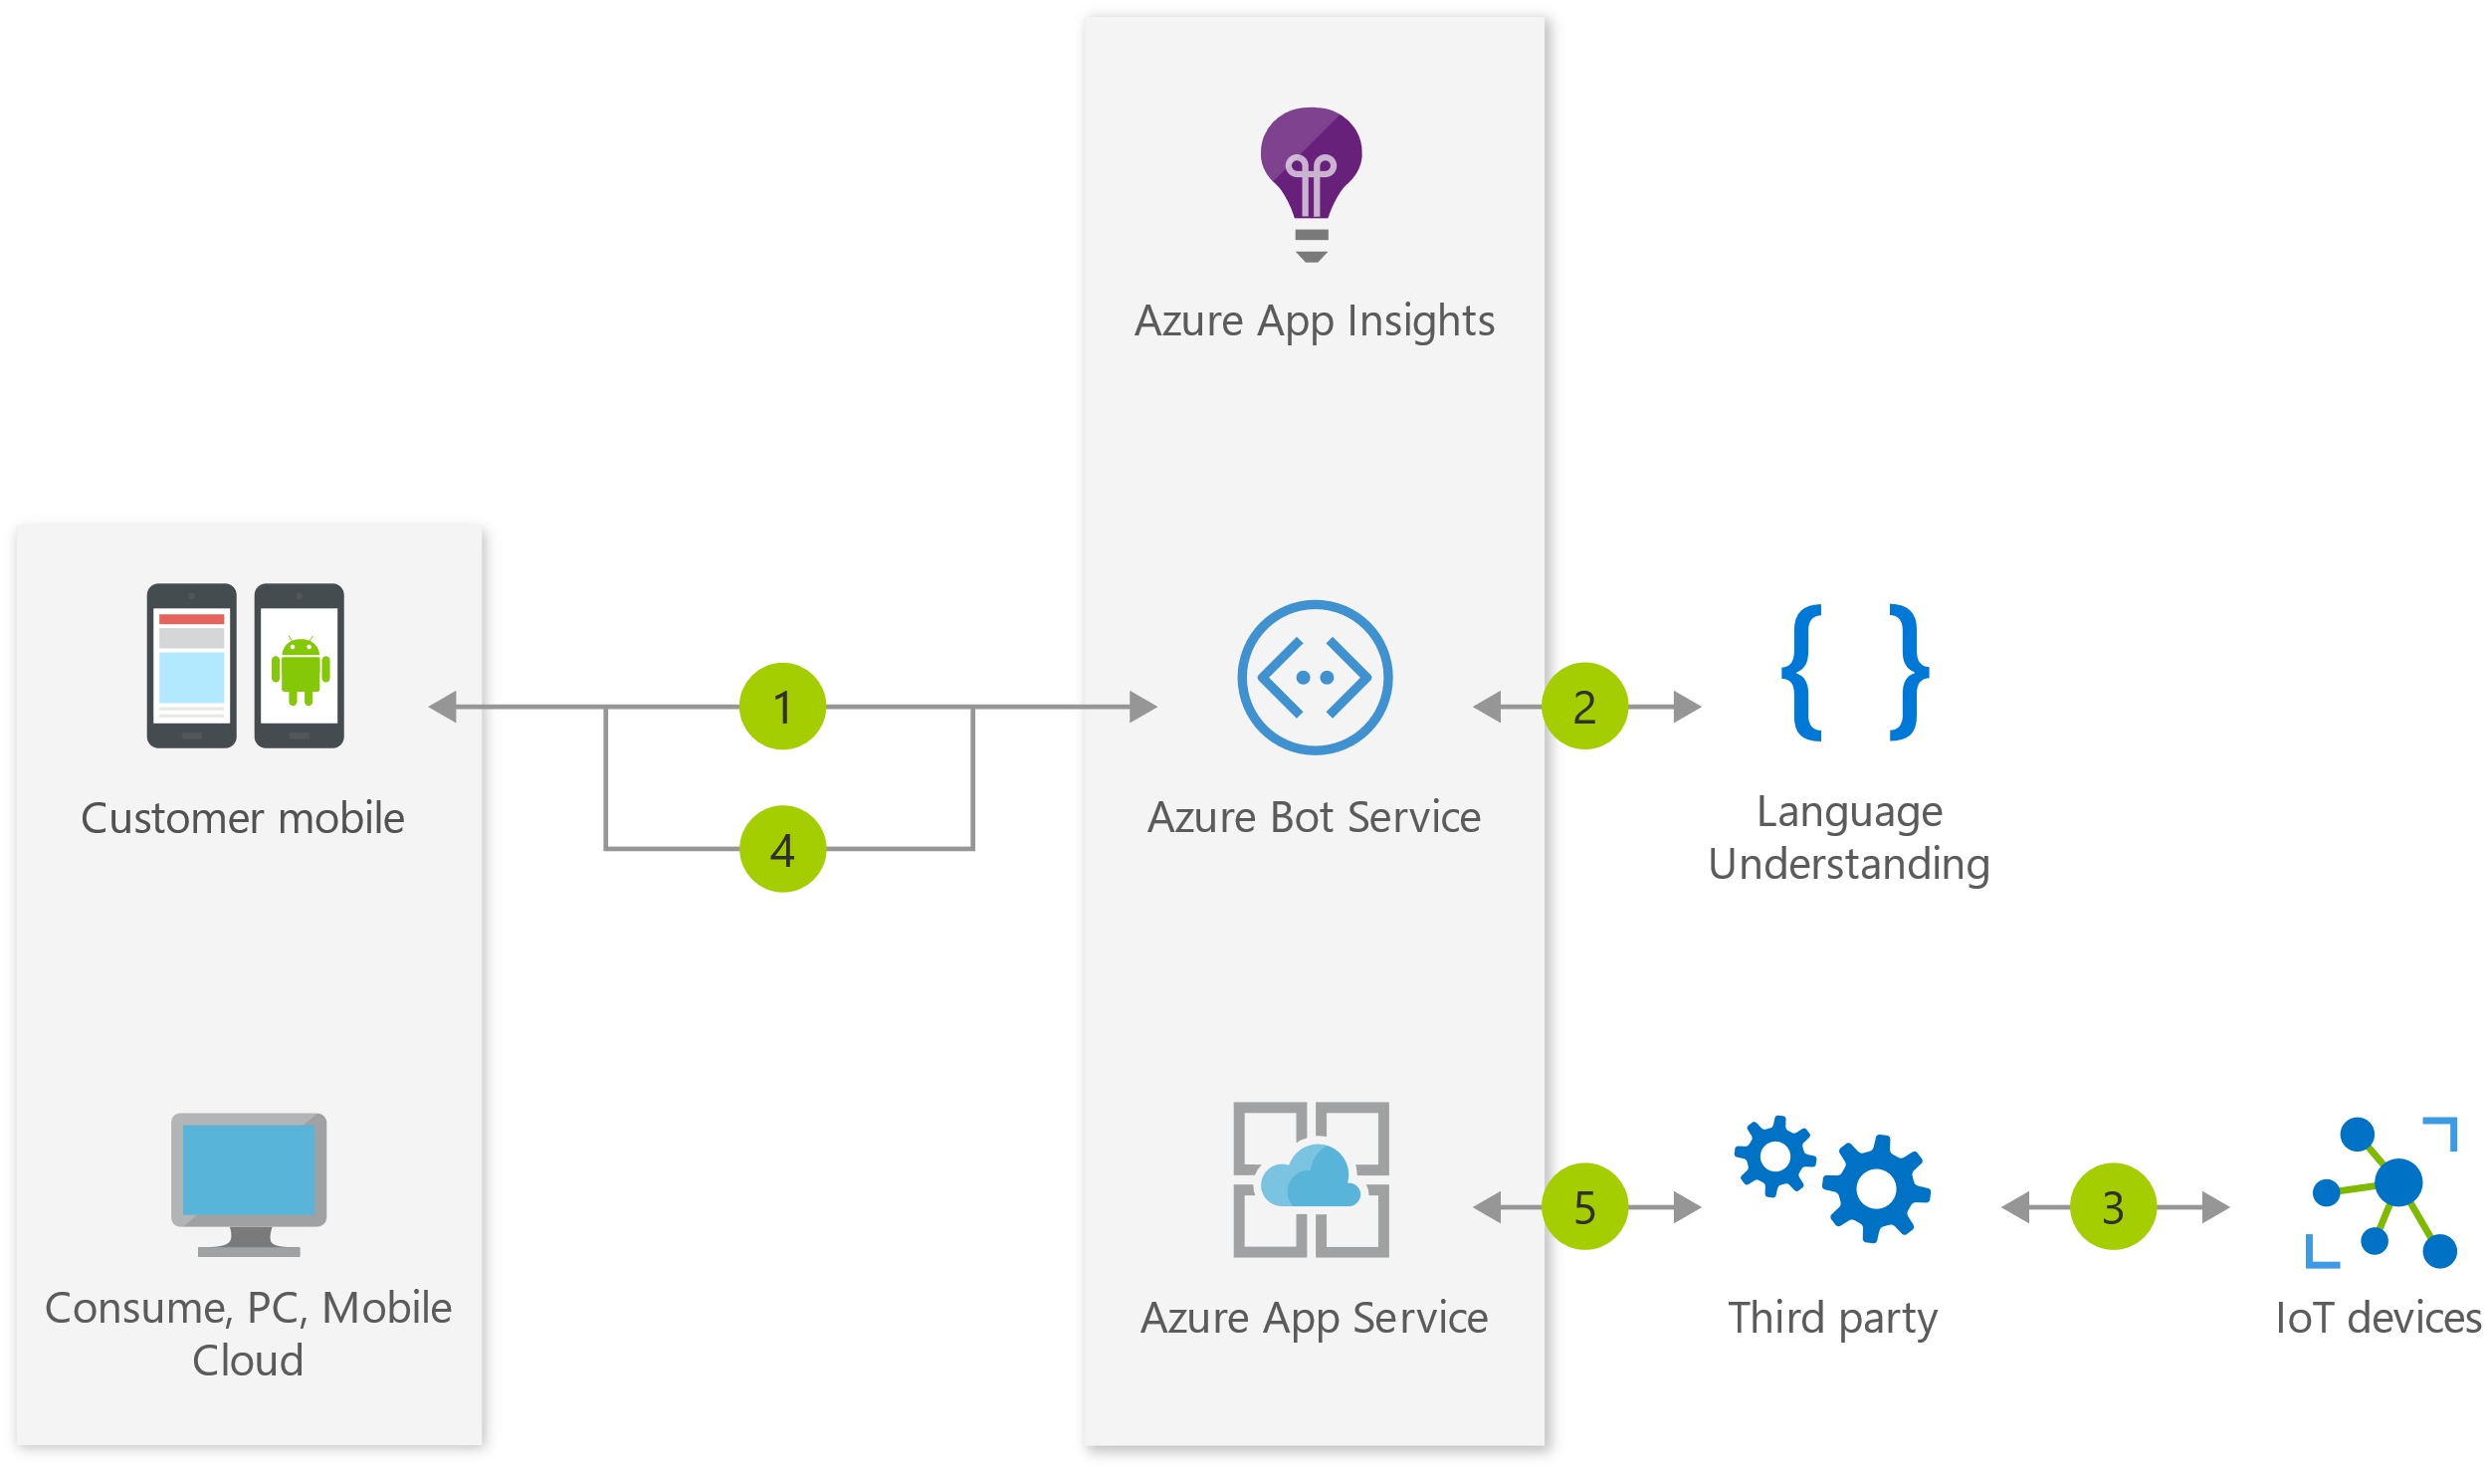
IoT bot
IoT bot
Example: Manage Philips Hue lights
5. Application insights gathers runtime telemetry
1. The accesses the IoT bot
2. Using voice or IM, the user asks the bot to turn on the lights via the IoT device
4. The results of the command are returned to the user
3. The request is relayed to a third party service that has access to the IoT device network
Key scenarios for bots

Slide 15
Common patterns
Task automation
Communicating with rich text and media
Access to knowledge and other content
Handling user interruptions
Bot to human handoff
Bot to web browser and back
Authentication
Bots in websites/apps

Slide 16
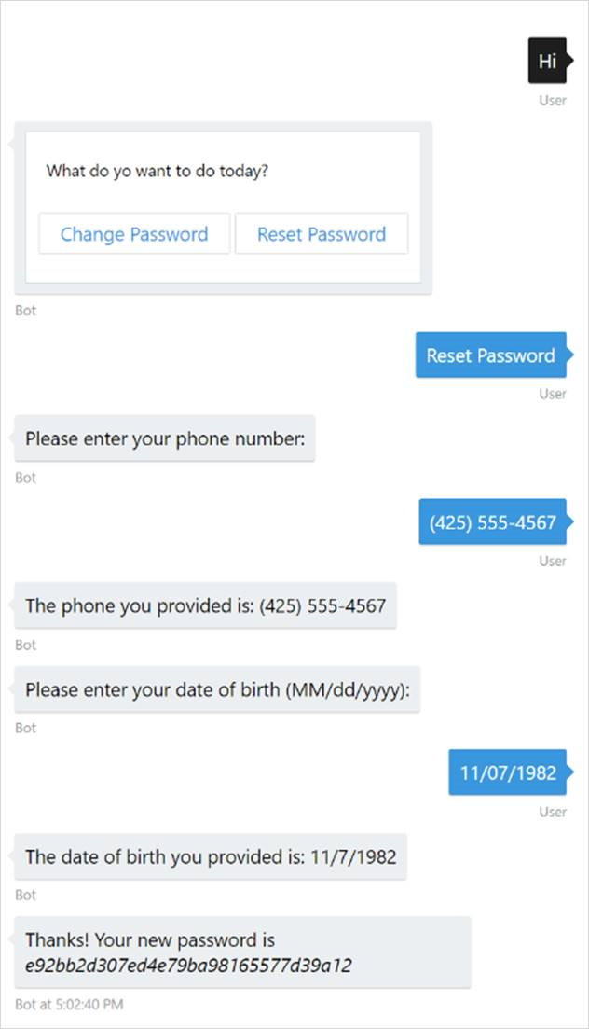
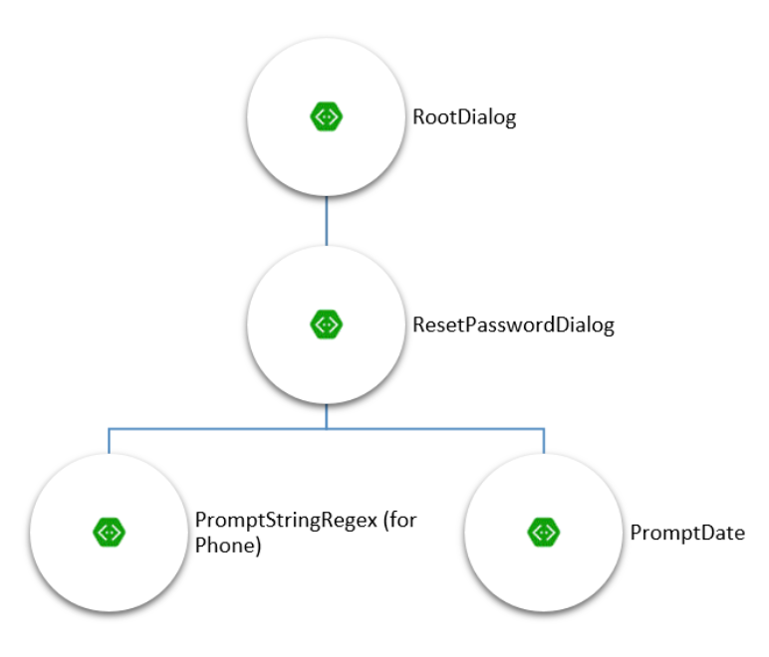
Task automation
Task automation
Example: password-reset
Common patterns

Slide 17

Bots in websites
Communicating with rich text and media
Text versus spoken
Options
Attachment
Hero card
Adaptive card
Carousel of cards
Suggested actions
Common patterns

Slide 18
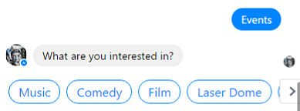
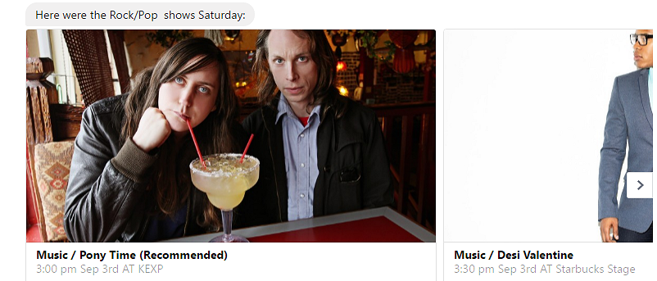
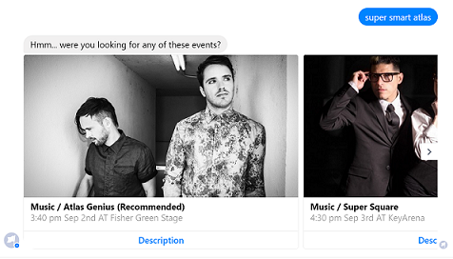
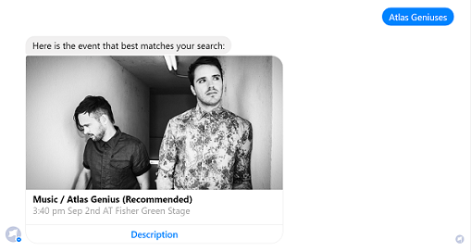
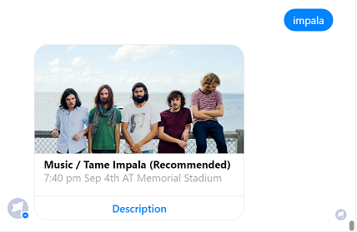
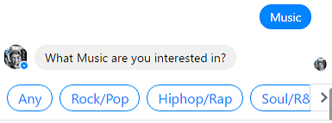
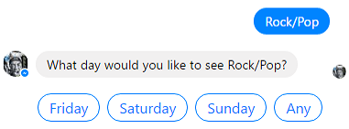
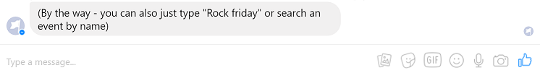
Access to knowledge and other content
Access to knowledge and other content
Azure Search
QnA Maker
LUIS
Bing APIs
Microsoft Graph
Common patterns

Slide 19
Bots in websites
Handling user interruptions
Expected interruptions
Unexpected interruptions
Switching topic of conversations
Apply AI
Have a default response
Common patterns

Slide 20
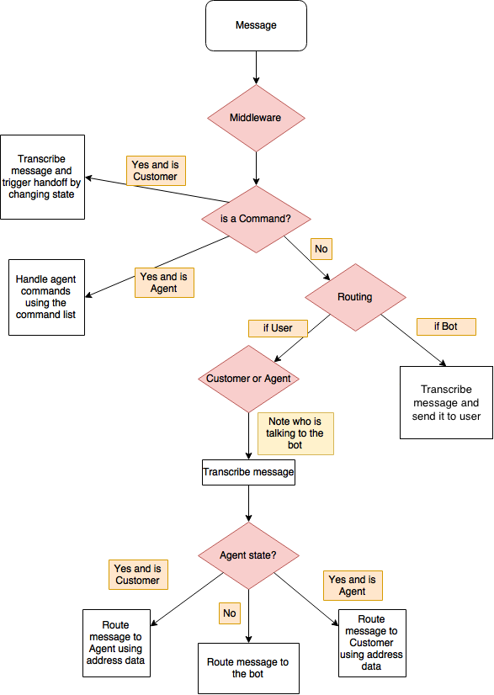
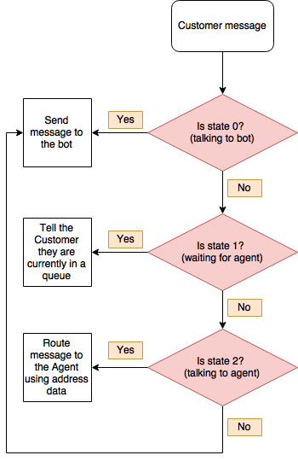
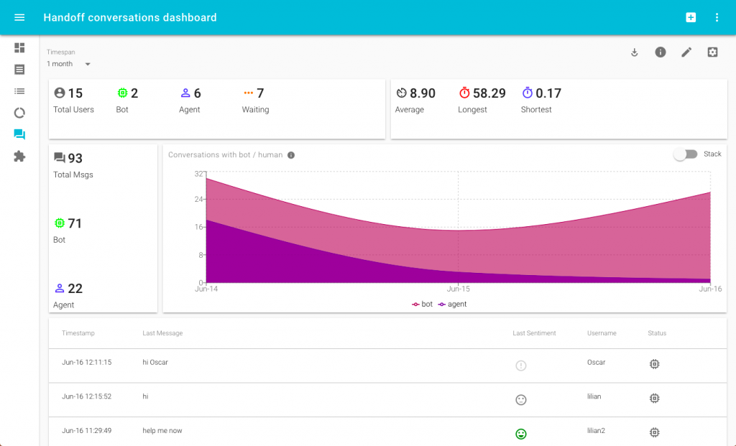
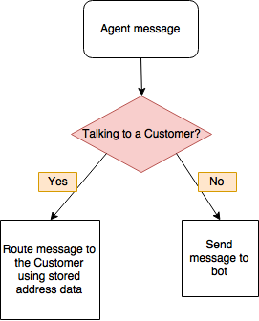
Bot to human handoff
Scenarios
Triage
Escalation
Supervision
Transitioning control
Routing messages between user and agent
Common patterns

Slide 21
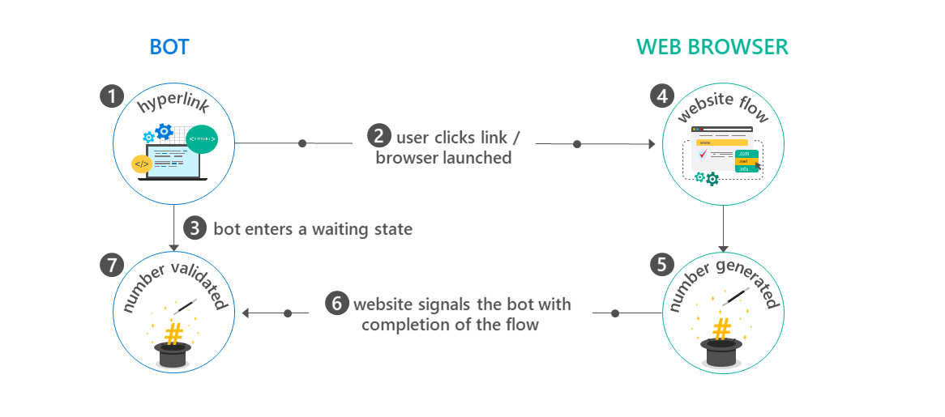
Bot to web browser and back
Bot to web browser and back
WARNING:
Transitioning from chat to web browser and back is not ideal, as switching between applications can easily confuse a user. To provide a better experience, many channels offer built-in HTML windows that a bot can use to present applications would otherwise appear in a web browser. This technique allows the user to remain within the conversation while still accessing external resources. This approach is conceptually similar to mobile applications managing authorization flows using OAuth within embedded web views.
Common patterns

Slide 22
Bots in websites
Authentication
Azure Bot Service makes it easier to implement
Eliminates magic code verification for some clients
Prior, your bot needed:
OAuth controllers and login links
To store the target client IDs and secrets
Perform user token management
Now:
Developers no longer need to handle that, ABS will
Support for AAD v1, AAD v2, GitHub, and others
Add, delete, and configure connection settings to various OAuth identity providers from the Azure Portal
Common patterns

Slide 23
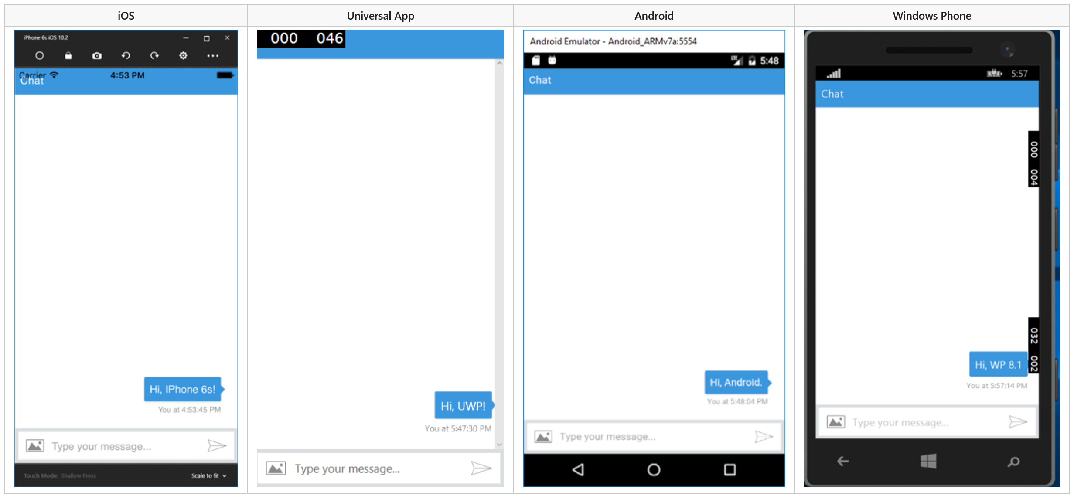
Bots in apps
Bots in apps
Common patterns

Slide 24
Bots in websites
Bots in websites
Embed a bot in a website
Skype web control
Open source web control
Using the backchannel mechanism
Direct Line API
Common patterns

Slide 25
New Bot Framework SDK v4
V3 SDK issues
V4 SDK goals
V4 SDK architecture

Slide 26
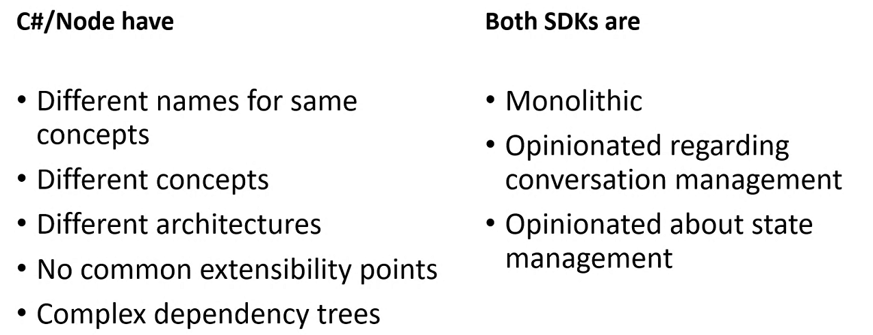
V3 SDK issues
V3 SDK issues
Bot Framework v4

Slide 27
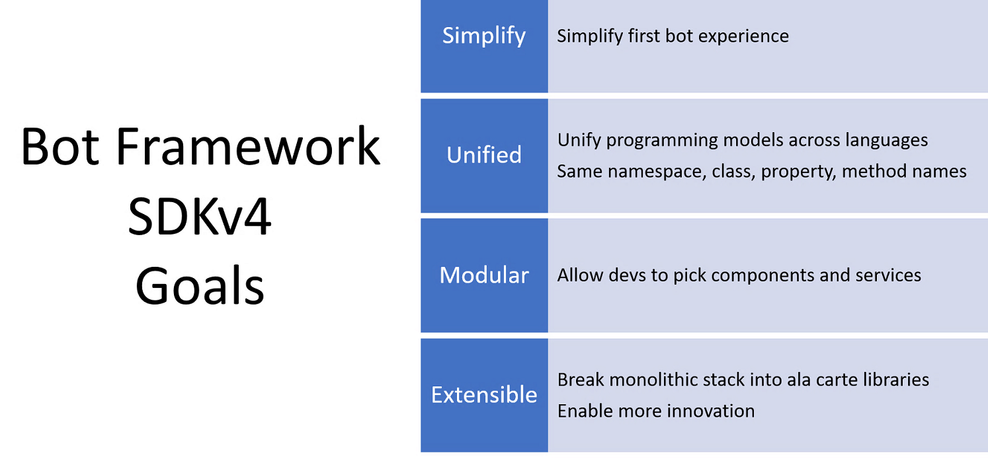
V4 SDK goals
V4 SDK goals
Bot Framework v4

Slide 28
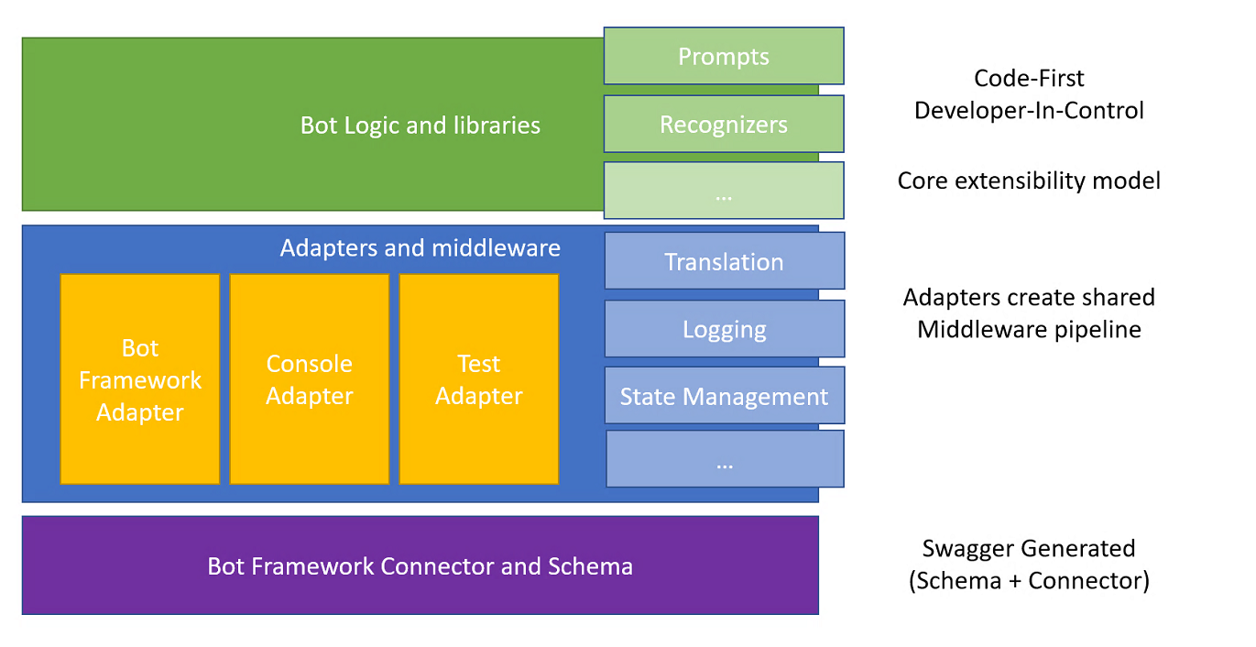
V4 SDK architecture
V4 SDK architecture
Bot Framework v4

Slide 29
Additional resources
The full Learn AI Bootcamp: https://github.com/Azure/LearnAI-Bootcamp
Our team: http://learnanalytics.microsoft.com/
AI Learning Paths: https://aischool.microsoft.com/learning-paths
Notes:
Use this slide to share additional content available that attendees should know about. In this section you can call out whitepapers or websites that you and your team have created.

